Slide 1

Business Meeting
PERSONAL FINANCING
BUSINESS GROUP
APRIL 2014
Presented by: KELVIN CHIN

Slide 2
1. Sales Performance Review
2. S.W.O.T Analysis
3. Regional Sales Achievement
4. Sales Performance by Loan Type
5. Sales Performance by Channel
6. Top 10 and Bottom 10 Branch/Service Center Sales Performance
7. New Branch Performance
8. Signed /Unsigned Status
9. 3 Months Activities Status
10. Promotion And Campaign
11. Others Activities
Agenda

Slide 3
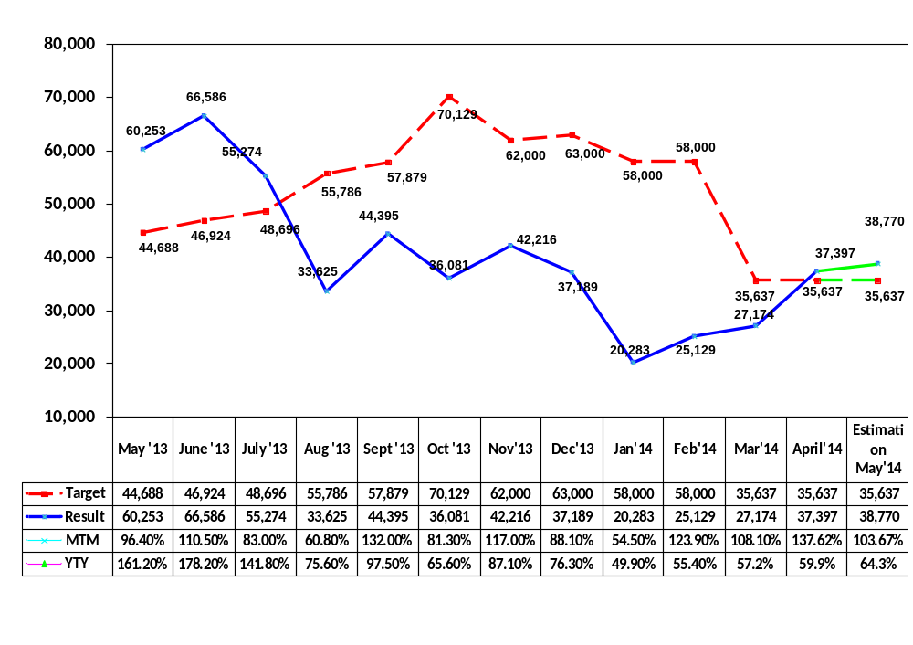
Sales Performance Review

Slide 4
Business SWOT Analysis
STRENGHS Cater to income segment RM1,600 Less Stringent Approval & submission criteria Strategy Continue focus on creating marketing awareness to the low income segment (Referral Network Scheme) Shout-out to the market on the ease of obtaining credit from ACS (Re-examine marketing materials with appropriate communication targeting this segment) | WEAKNESSES Inefficient Recruitment Process Excess vacant position (Management & Non-management staff) Low Marketing & Branding initiatives & awareness (ATL/ BTL) Insufficient training, coaching and monitoring of sales team Strategy Weekly monitoring of the hiring process Conduct regular marketing campaigns to create pull factor with ATL & BTL communications) Regular daily reporting and monitoring
OPPORTUNITIES Untapped market at Aeon Big & Aeon Co Market segment (mid to high income) Strategy Plan regular road shows with sufficient manpower during AB & AC event days Develop competitive products targeting RM3k above market segment | THREATS Increase in prospects hitting DSR limit Increased competition from competitors with new products with strong marketing budget and campaign (Cheaper rates) Advancement in CA capabilities of competitors Strategy 1. Develop products to cater to the limited purchasing power of customers (Extension of tenure from 5yrs to 8yrs)

Slide 5
Regional Sales Achievement
RM ‘000
Region | Feb’14 |  |  |  | Mar’13 |  |  |  | April’14 |  |  |  | Estimation May’14
 | Sales | % Target | % MTM | % YTY | Sales | % Target | % MTM | % YTY | Sales | % Target | % MTM | % YTY | Sales | % Target
Total | 25,129 | 46.9% | 123.8% | 57.7% | 27,174 | 26,728 | 108.1% | 60.1% | 37,396 | 139.9% | 137.6% | 62.8% | 31,429 | 117.6%
NRO | 4,202 | 56.5% | 131.8% | 107.5% | 4,350 | 118.9% | 103.5% | 96.1% | 5,572 | 152.3% | 128.1% | 82.8% | 4,051 | 110.7%
CRO | 13,484 | 51.0% | 128.2% | 46.3% | 14,263 | 92.5% | 105.8% | 47.4% | 20,484 | 132.8% | 143.6% | 52.9% | 16,888 | 109.5%
SRO | 2,150 | 23.8% | 99.4% | 56.9% | 2,843 | 72.5% | 132.2% | 78.0% | 3,209 | 81.9% | 112.9% | 68.2% | 2,969 | 75.8%
ERO | 2,837 | 54.0% | 125.8% | 67.5% | 3,315 | 158.5% | 116.8% | 77.0% | 4,657 | 222.7% | 140.5% | 83.3% | 3,689 | 176.4%
S’wak | 1,079 | 64.1% | 117.8% | 77.8% | 1,389 | 138.3% | 128.7% | 90.9% | 1,936 | 192.8% | 139.4% | 98.9% | 2,044 | 203.6%
Sabah | 1,105 | 35.0% | 125.4% | 174.0% | 1,007 | 160.6% | 91.1% | 92.0% | 1,488 | 237.4% | 147.8% | 90.2% | 1,622 | 258.7%
Notes:
MAR APR MAY JUN JUL AUG SEP OCT NOV DEC JAN FEB
NRO 3,659 3,659 3,659 6,329 6,645 6,978 8,778 9,151 9,271 8,130 8,083 7,988
CRO 15,427 15,427 15,427 26,685 28,019 29,421 37,011 38,583 39,088 34,280 34,080 33,680
SRO 3,920 3,920 3,920 6,781 7,120 7,476 9,405 9,804 9,933 8,711 8,660 8,559
ERO 2,091 2,091 2,091 3,617 3,797 3,987 5,016 5,229 5,298 4,646 4,619 4,565
SWK 1,004 1,004 1,004 1,736 1,823 1,914 2,408 2,510 2,543 2,230 2,217 2,191
SBH 627 627 627 1,085 1,139 1,196 1,505 1,569 1,589 1,394 1,386 1,369

Slide 6
Sales Performance by Loan Type
RM ‘000
 | Feb’14 |  |  |  | Mar’14 |  |  |  | April’14
 | Sales | % Share | % MTM | % YTY | Sales | % Share | % MTM | % YTY | Sales | % Share | % MTM | % YTY
Total | 25,129 | 100.0% | 123.89% | 58.15% | 27,174 | 100.0% | 108.1% | 60.1% | 37,396 | 100.0% | 137.6% | 62.8%
Normal | 13,124 | 52.2% | 113.65% | 157.98% | 12,652 | 46.6% | 96.4% | 107.1% | 14,033 | 37.5% | 110.9% | 79.3%
Express Card | 8,244 | 32.8% | 138.14% | 39.50% | 9,381 | 34.5% | 113.8% | 45.1% | 14,584 | 39.0% | 155.5% | 54.3%
Low Interest | 1,859 | 7.4% | 121.26% | 22.59% | 2,858 | 10.5% | 153.7% | 45.9% | 5,101 | 13.6% | 178.5% | 61.4%
Refinancing | 5,737 | 7.6% | 154.09% | 33.12% | 2,283 | 8.4% | 39.8% | 36.4% | 3,680 | 9.8% | 161.2% | 55.0%
FACC | 0 | 0.0% | 0.0% | 0.00% | 0 | 0.0% | 0.0% | 0.0% | 0 | 0.0% | 0.0% | 0.0%

Slide 7
Sales Performance by Channel
RM ‘000
Sales Channel | Feb’13 |  |  |  | March’13 |  |  |  | April
 | MYR | % Share | % MTM | % YTY | MYR | % Share | % MTM | % YTY | MYR | % Share | % MTM | % YTY
Total | 25,129 | 100.0% | 131.3% | 83.0% | 27,174 | 100.0% | 108.1% | 60.1% | 37,397 | 100.0% | 137.6% | 62.6%
CSU | 15,443 | 75.6% | 117.8% | 167.0% | 15,437 | 91.2% | 100.1% | 77.1% | 33,387 | 89.3% | 216.3% | 74.4%
Direct Mail | 425 | 2.1% | 738.0% | 41.0% | 104 | 0.4% | 24.5% | 151.1% | 80 | 0.2% | 76.9% | 258.1%
Recruiter | 6 | 0.1% | 100.0% | 0.29% | 0 | 0.0% | 0.0% | 0.0% | 0 | 0.0% | 0.0% | 0.0%
Tele HQ | 1,846 | 9.1% | 85.3% | 85.0% | 1,795 | 6.7% | 97.1% | 14.5% | 3,423 | 9.2% | 190.7% | 24.8%
Website | 2,690 | 13.8% | 1312.2% | 139.0% | 438 | 1.6% | 16.3% | 82.7% | 457 | 1.2% | 104.3% | 58.5%
Other | 0 | 0.0% | 0.0% | 0.0% | 7 | 0.1% | 0.0% | 0.0% | 51 | 0.1% | 728.6% | 81.0%

Slide 8
TOP 10 & Bottom 10 Branch /
Service Center Sales Performance
RM ‘000
 | Branch/Service Centre | April’14 Sales Amount |  |  | April’14 Sales Count
 |  | MYR | % Share | % MTM | Count | % Share | % MTM
1 | KUANTAN | 1,494,800 | 4.5% | 137.9% | 269 | 4.2% | 139.4%
2 | KOTA KINABALU | 1,488,300 | 4.5% | 138.6% | 275 | 4.3% | 127.3%
3 | KUCHING | 1,249,400 | 3.7% | 143.0% | 291 | 4.6% | 130.5%
4 | SETAPAK | 1,221,600 | 3.7% | 157.1% | 198 | 3.1% | 127.7%
5 | ALOR SETAR | 1,181,100 | 3.5% | 123.1% | 278 | 4.4% | 124.1%
6 | KOTA BHARU | 1,119,700 | 3.4% | 168.7% | 178 | 2.8% | 154.8%
7 | SRI GOMBAK | 1,105,000 | 3.3% | 170.5% | 205 | 3.2% | 149.6%
8 | BANTING | 1,104,400 | 3.3% | 139.7% | 215 | 3.4% | 122.2%
9 | KUALA TERENGGANU | 1,097,000 | 3.3% | 127.7% | 194 | 3.0% | 126.8%
10 | PENANG | 1,084,000 | 3.2% | 138.8% | 235 | 3.7% | 129.1%
1 | ONE UTAMA | 377,500 | 1.1% | 129.5% | 63 | 1.0% | 118.9%
2 | KULAI JAYA | 287,500 | 0.9% | 123.7% | 51 | 0.8% | 113.3%
3 | JOHOR BHARU | 262,600 | 0.8% | 163.6% | 45 | 0.7% | 155.2%
4 | BATU PAHAT AEON BIG | 176,600 | 0.5% | 118.5% | 36 | 0.6% | 124.1%
5 | JOHOR BHARU AEON BIG | 113,500 | 0.3% | 74.2% | 25 | 0.4% | 78.1%
6 | TAMAN CONNAUGHT | 110,000 | 0.3% | 108.9% | 19 | 0.3% | 95.0%
7 | WANGSA MAJU | 100,000 | 0.3% | 95.7% | 21 | 0.3% | 100.0%
8 | MID VALLEY AEON BIG | 82,000 | 0.2% | 0.0% | 15 | 0.2% | 0.0%
9 | BUKIT RIMAU | 53,500 | 0.2% | 137.2% | 12 | 0.2% | 150.0%
10 | BUKIT RAJA | 15,000 | 0.0% | 76.9% | 3 | 0.0% | 50.0%

Slide 9
New Branch Performance 2013
Launch Date |  |  | Dec | Jan | Feb | Mar | Apr
Kluang | 25/7/2013 | Head Count | 10 | 10 | 10 | 10 | 9
 |  | Total Aplication | 356 | 201 | 239 | 191 | 210
 |  | Total Sales | 548,400 | 304,500 | 376,600 | 259,800 | 470,700
 |  | Productivity (Count) | 36 | 20 | 24 | 19 | 23
 |  | Productivity (RM) | 54,840 | 30,450 | 37,660 | 25,980 | 52,300
Kota Damansara | 12/8/2013 | Head Count | 7 | 7 | 8 | 11 | 11
 |  | Total Aplication | 256 | 164 | 230 | 283 | 283
 |  | Total Sales | 461,300 | 371,200 | 284,900 | 485,000 | 447,700
 |  | Productivity (Count) | 37 | 23 | 29 | 26 | 26
 |  | Productivity (RM) | 65,900 | 53,029 | 35,613 | 44,091 | 40,700
Kulai Jaya | 27/11/2013 | Head Count | 3 | 4 | 3 | 7 | 9
 |  | Total Aplication | 26 | 49 | 71 | 151 | 179
 |  | Total Sales | 40,500 | 67,800 | 112,000 | 232,500 | 287,500
 |  | Productivity (Count) | 9 | 12 | 24 | 22 | 20
 |  | Productivity (RM) | 13,500 | 16,950 | 37,333 | 33,214 | 31,944
Bukit Raja | 12/6/2013 | Head Count |  |  |  | 3 | 3
 |  | Total Aplication |  |  |  | 16 | 14
 |  | Total Sales |  |  |  | 19,500 | 15,000
 |  | Productivity (Count) |  |  |  | 2 | 5
 |  | Productivity (RM) | #DIV/0! | #DIV/0! | #DIV/0! | 2,438 | 5,000
Kapar | 20/12/2013 | Head Count |  | 4 | 6 | 7 | 7
 |  | Total Aplication |  | 25 | 141 | 200 | 322
 |  | Total Sales |  | 25,000 | 213,800 | 179,900 | 642,600
 |  | Productivity (Count) |  | 6 | 24 | 29 | 46
 |  | Productivity (RM) | #DIV/0! | 6,250 | 35,633 | 25,700 | 91,800
Connaught | 20/12/2013 | Head Count |  | 4 | 5 | 6 | 9
 |  | Total Aplication |  | 82 | 114 | 111 | 107
 |  | Total Sales |  | 158,100 | 135,800 | 101,000 | 110,000
 |  | Productivity (Count) |  | 21 | 23 | 19 | 12
 |  | Productivity (RM) | #DIV/0! | 39,525 | 27,160 | 16,833 | 12,222

Slide 10
New Branch Performance 2013
Launch Date |  |  | Dec | Jan | Feb | Mar | Apr
Wangsamaju | 23/12/2013 | Head Count |  | 1 | 4 | 7 | 7
 |  | Total Aplication |  | 10 | 33 | 79 | 82
 |  | Total Sales |  | 12,500 | 38,000 | 104,500 | 100,000
 |  | Productivity (Count) |  | 10 | 8 | 11 | 12
 |  | Productivity (RM) | #DIV/0! | 12,500 | 9,500 | 14,929 | 14,286
Batu Pahat AB | 23/12/2013 | Head Count |  |  | 4 | 8 | 8
 |  | Total Aplication |  |  | 78 | 117 | 117
 |  | Total Sales |  |  | 78,500 | 149,000 | 176,600
 |  | Productivity (Count) |  |  | 20 | 15 | 15
 |  | Productivity (RM) | #DIV/0! | #DIV/0! | 19,625 | 18,625 | 22,075
Shah Alam Sec 23 | 3/1/2014 | Head Count |  |  | 5 | 6 | 7
 |  | Total Aplication |  |  | 66 | 289 | 233
 |  | Total Sales |  |  | 74,000 | 314,400 | 427,700
 |  | Productivity (Count) |  |  | 13 | 48 | 33
 |  | Productivity (RM) | #DIV/0! | #DIV/0! | 14,800 | 52,400 | 61,100
Johor Bharu (Aeon Big) | 3/1/2014 | Head Count |  |  | 8 | 7 | 7
 |  | Total Aplication |  |  | 117 | 94 | 97
 |  | Total Sales |  |  | 95,000 | 153,000 | 113,500
 |  | Productivity (Count) |  |  | 15 | 13 | 14
 |  | Productivity (RM) | #DIV/0! | #DIV/0! | 11,875 | 21,857 | 16,214
Mid Valley (Aeon Big) |  | Head Count |  |  |  |  | 3
 |  | Total Aplication |  |  |  |  | 53
 |  | Total Sales |  |  |  |  | 82,000
 |  | Productivity (Count) |  |  |  |  | 18
 |  | Productivity (RM) |  |  |  |  | 27,333
Bukit Rimau |  | Head Count |  |  |  |  | 5
 |  | Total Aplication |  |  |  |  | 57
 |  | Total Sales |  |  |  |  | 53,500
 |  | Productivity (Count) |  |  |  |  | 11
 |  | Productivity (RM) |  |  |  |  | 10,700

Slide 11
Signed / Unsigned Sales Status
RM ‘000
Region | Feb’14 |  |  | Mar’14 |  |  | April’14
 | Approval | Sales | S&P (%) | Approval | Sales | S&P (%) | Approval | Sales | S&P (%)
Total | 25,245 | 25,129 | 100.5% | 29,794 | 27,174 | 109.6% | 38,706 | 37,397 | 96.6%
NRO | 4,501 | 4,202 | 107.1% | 5,026 | 4,350 | 115.5% | 5,814 | 5,572 | 95.8%
CRO | 12,803 | 13,484 | 94.9% | 15,570 | 14,263 | 109.2% | 21,250 | 20,484 | 96.4%
SRO | 2,505 | 2,150 | 116.5% | 3,032 | 2,843 | 106.6% | 3,307 | 3,209 | 97.0%
ERO | 3,083 | 2,837 | 108.7% | 3,603 | 3,315 | 108.7% | 4,736 | 4,657 | 98.3%
S’wak | 1,145 | 1,079 | 106.1% | 1,499 | 1,389 | 107.9% | 2,076 | 1,936 | 93.3%
Sabah | 1,205 | 1,105 | 109.0% | 1,062 | 1,007 | 105.5% | 1,423 | 1,488 | 104.6%

Slide 12
TOTAL SUBMISSION/SALES HEAD COUNT
Month | Total Sub (#) | Total Working Days/Month | Avg. Sub(#) /Working Days | Total Head Count | Avg.Sub(#)Sales Staff/Month
OCTOBER’13 | 10,837 | 24 | 451 | 117 | 93
NOVEMBER’13 | 13,947 | 25 | 557 | 134 | 104
DECEMBER’13 | 13,629 | 26 | 524 | 163 | 83
JANUARY’14 | 10,128 | 22 | 460 | 177 | 57
FEBRUARY’14 | 14,359 | 27 | 531 | 211 | 68
MARCH’14 | 13,073 | 24 | 544 | 223 | 58
APRIL’14 | 14,898 | 25 | 595 | 228 | 65
ESTIMATION MAY’14 | 13,564 | 24 | 565 | 227 | 59
Notes:
SEPT 25
OCT 24
NOV 25
DEC 26
JAN 22
FEB 25

Slide 13
Thank You
Company Slogan 2013
" –Second Stage- Convenient, Beneficial, Secure “

Slide 14
3 Months Activities / Performance
PF LUCKY DRAW CAMPAIGN
Apr’14 |  | May’14 |  |  |  | June’14 |  |  |  | July’14
W3 | W4 | W1 | W2 | W3 | W4 | 1W | 2W | 3W | 4W | 1W | 2W
1st round (21st Apr – 20th May 2014)
2nd round (21st May – 20 June 2014)
3rd round (21st June – 20th July 2014)

Slide 15
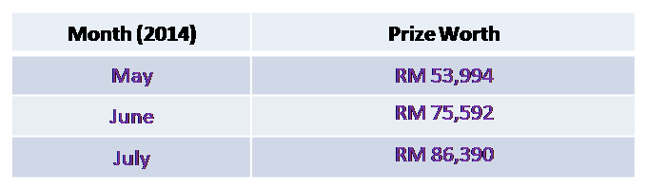
Promotion & Campaign
Aeon-iCash Lucky Draw Campaign
Purpose: Sales Target RM 117.9 Mil
Period: 21st April 2014 – 20th July 2014
Location: Nationwide
Objective: To increase PF Sales.
Camapign Mechanism:
Lucky draw is held once a month (May, June & July 2014)
Eligibility to all S&P customers on any loan amount.
Prizes: Electrical Appliances & IT Gadgets.
Total Prizes worth: RM 215,976
Marketing Collaterals: Flyers & Bunting.
Printing Cost: RM 100,000.
Flyers - 3 types of flyers due to prizes are different every month.
- Segregation of flyers: 34,013 pieces x (3 types) x (49 CSU).
Bunting – 1 at each CSU.

Slide 16
Other Activities
Issue (Why) | When | By Who | Where | Target (What , How) | How Much
PF Sales target: RM800m | 28th Feb 2015 | PF Prod Devlp | Nationwide | PF product feature enhancement: Aeon-iCash Extension Tenure | RM200k (Marketing Collateral)
 | 28th Feb 2015 | PF Prod Devlp | Nationwide | PF product feature enhancement: Aeon-iCash Cash Back | ~
Increase in PF Sales Revenue | 28th Feb 2015 | PF Prod Devlp | Nationwide | Aeon-iCash profit/ interest rate hike up | Nil
PF Sales SOP | 23th April 2014 | PF Prod Devlp | HQ | 100% completion as at 23st April 2014 | Nil
PF Submission CRM Roll Out @ CSU –Hardware Issue | 21st April 2014 | PF O/I | Nationwide | 100% roll out at Central Region. Current Regional hardware specification incompatible for CRM | Nil
Referral Cash Back Scheme | 20th May 2014 | PF S&M | Nationwide |  | Nil
Automation - Daily Reporting & Sales Incentive Tabulation | 20th May 2014 | PF O/A | HQ | To reduce manual work thus reducing human error | Nil
New CC & PF Incentive Scheme | 21st May 2014 | PF | Nationwide | New combi incentive scheme for CC & PF sales team merger | Nil

